Slide 1
London’s Neighborhood comparison to Singapore’s neighborhood

Slide 2
Many business can be make on these two big cities
Singapore need more restaurants
London needs more shopping center
Both cities may need more coffee shop

Slide 3
Data acquisition and clearing
Foursquare location neighborhood data
Transforming result to a pandas dataframe
Removing unusable columns
Getting new dataframe with only used categories

Slide 4
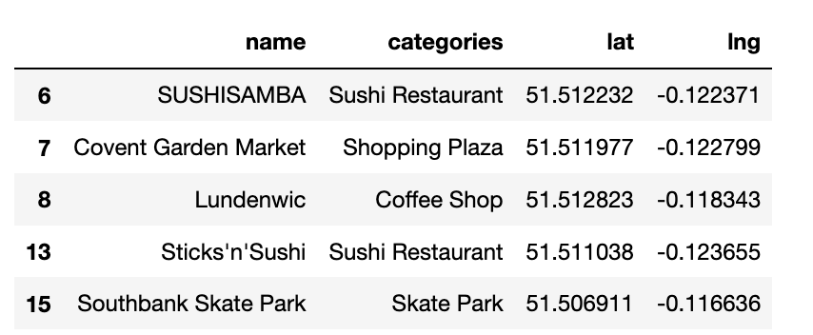
London places

Slide 5
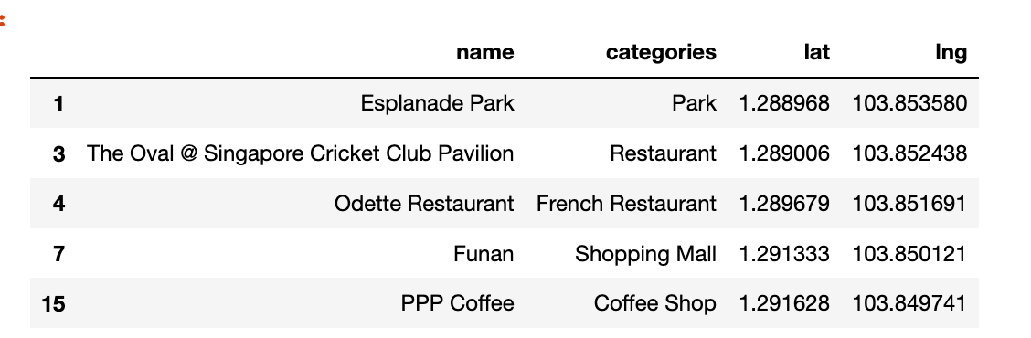
Singapore place

Slide 6
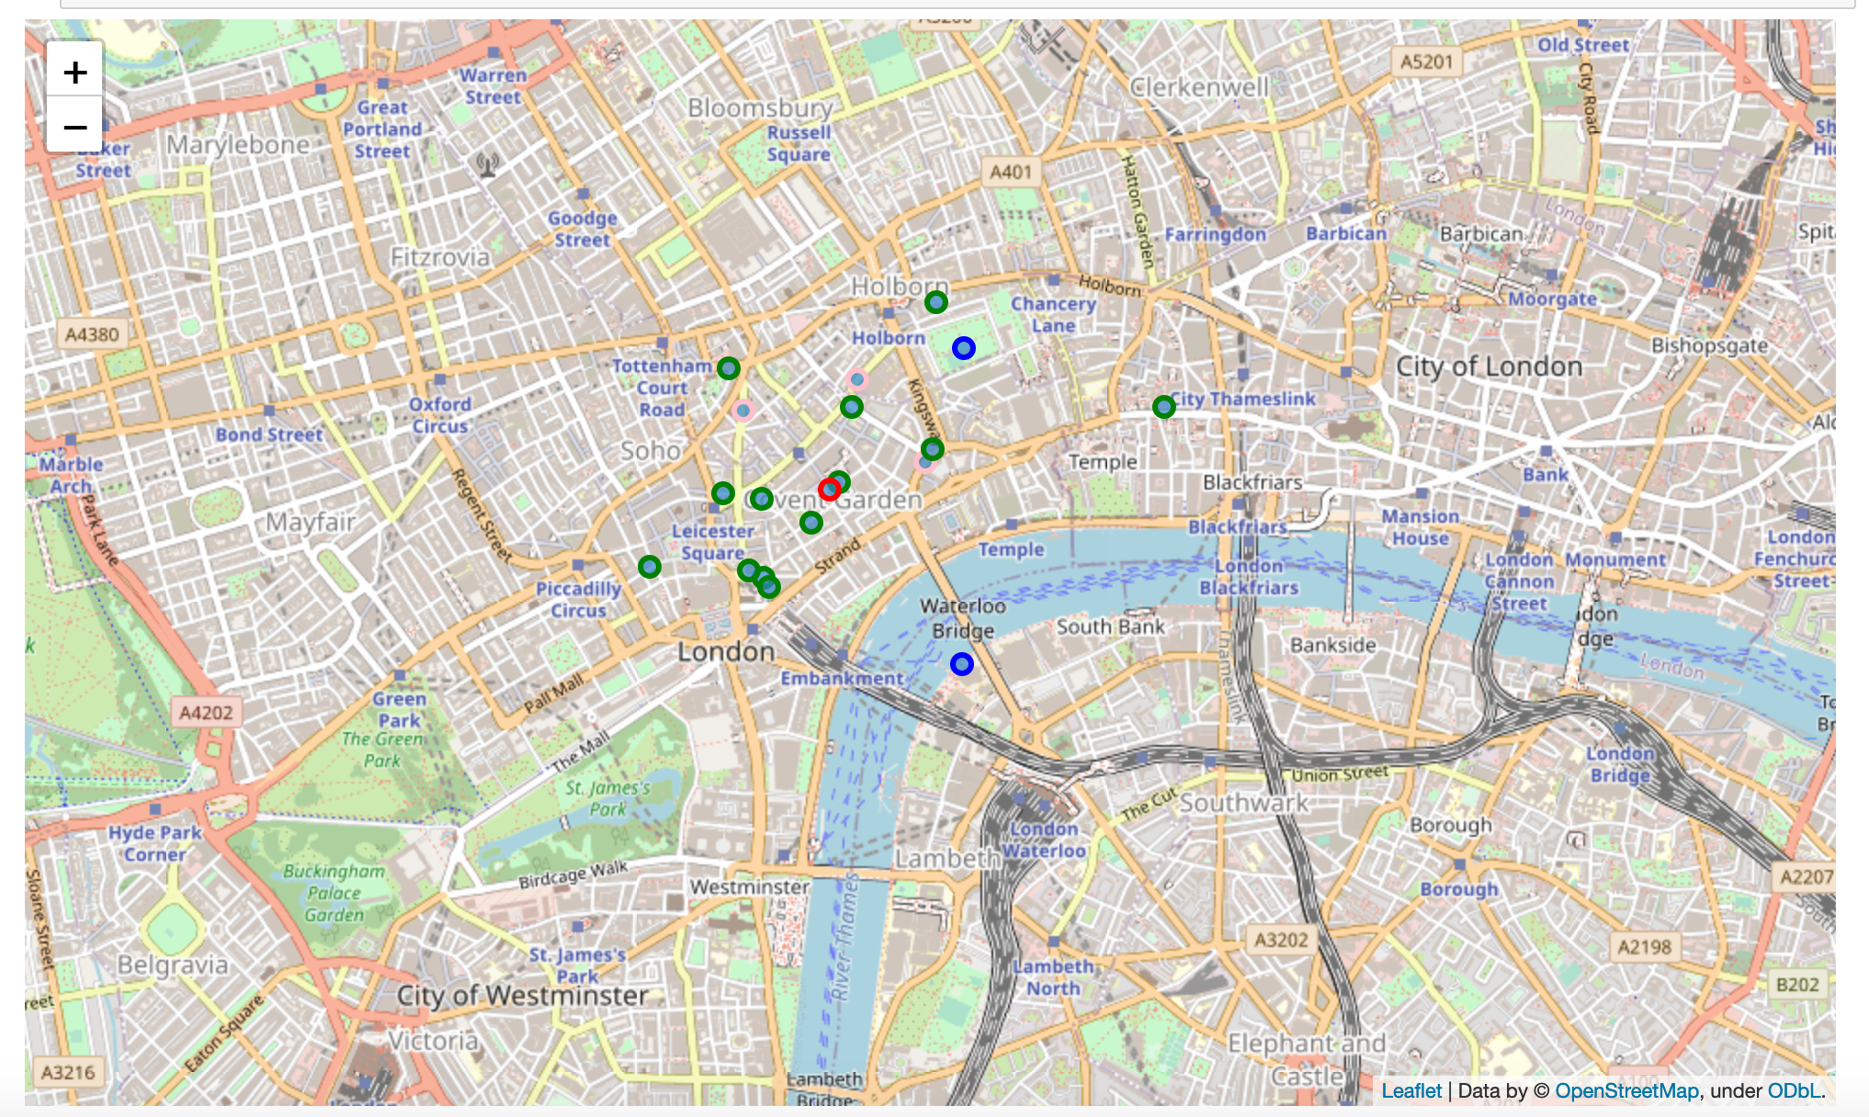
London Map

Slide 7
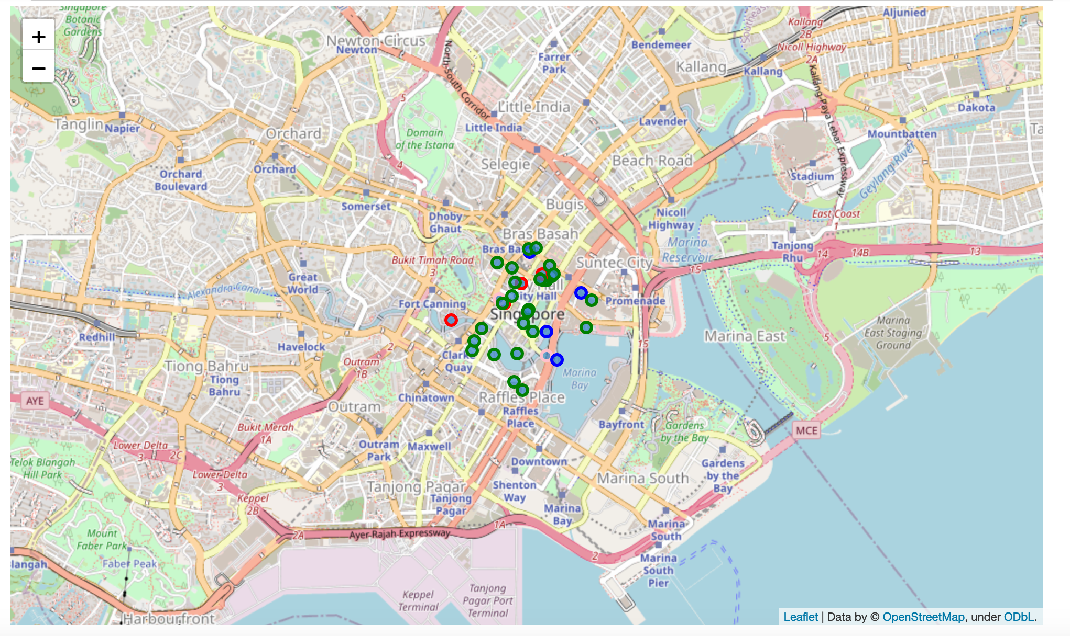
Singapore Map

Slide 8
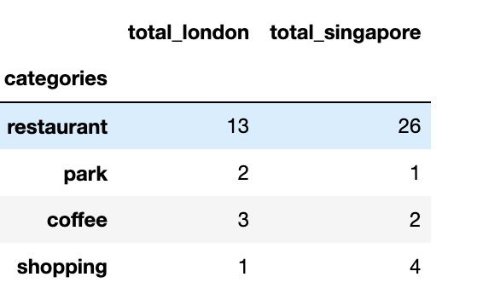
Comparison
https://www.dropbox.com/s/9703uj2u6l5dt1p/capstone_project.docx?dl=0

Slide 9
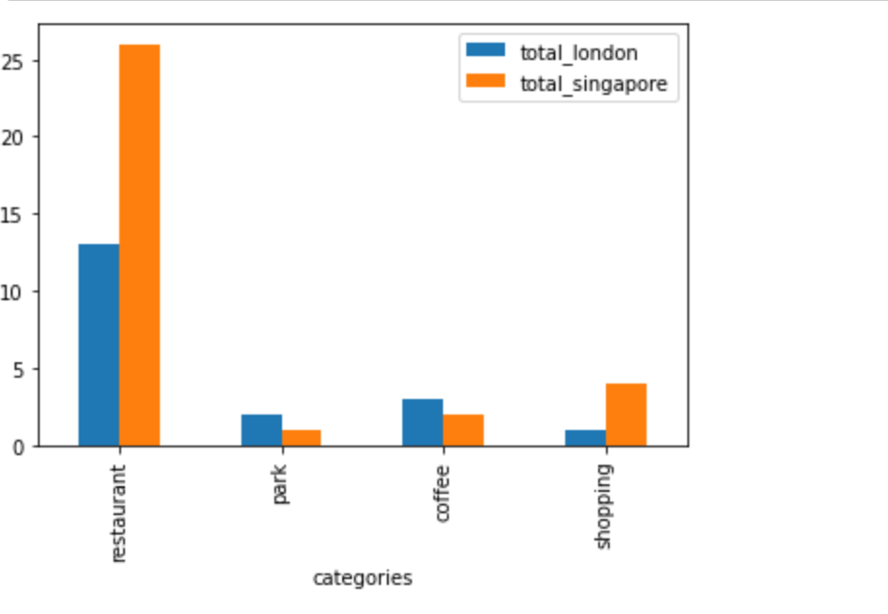
Comparison

Slide 10
Conclusion
This report attempts to make a comparison of two big city using some king of categories. We can use more data to make a better comparison and also predict where is the place to make a business in food or in clothes. If someone want to start a business in these two cities in food or an clothes in these two cities this report can be a good start.

